Slide 1
Quick Introduction to SBOL Visual 3.0
May 2021
This work is licensed under a Creative Commons Attribution 4.0 International License.

Slide 2

Diagram Elements
Sequence Feature Glyphs
Molecular Species Glyph
Module
Nucleic Acid
Backbone
GFP
pTet
gfp
tetR
Interactions
Labels
Reverse Complement
Sequence Feature Glyphs
Interaction Node
aTc
Grey text and lines (including this) are annotations

Slide 3
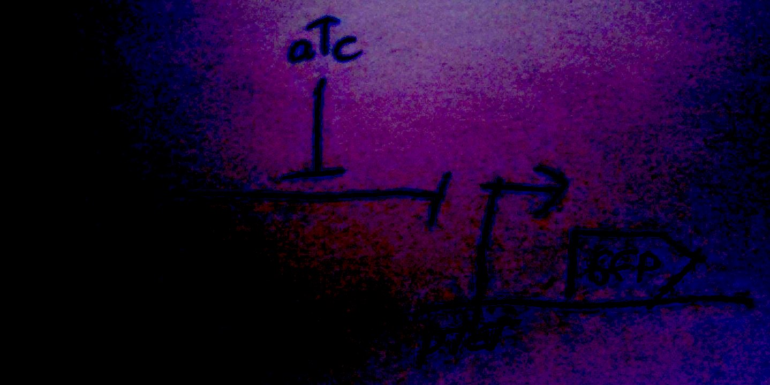
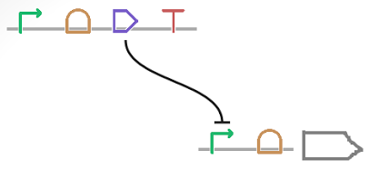
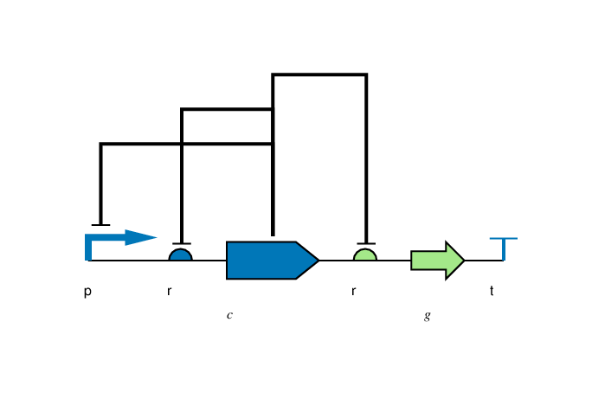
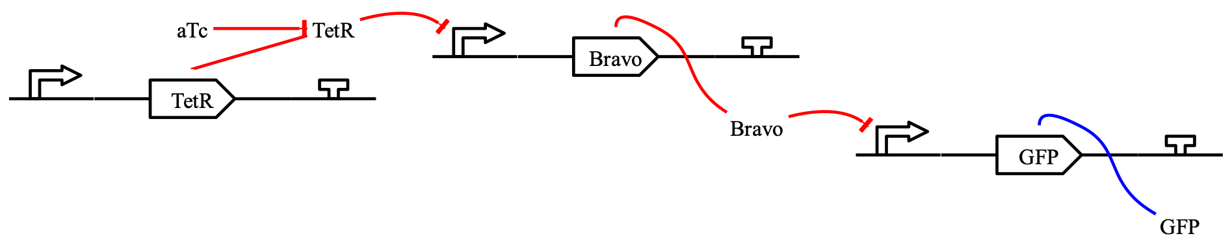
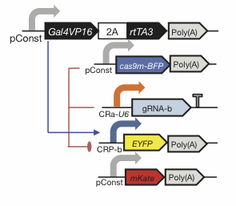
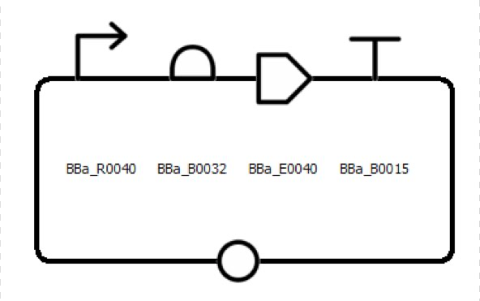
Flexibility of Style
Color, Text, Scaling, Strands, Styling: all your choice

Slide 4



Complex Example Diagram
tetr
J23101
TetR
∅
GFP
∅
gfp
pTet
The top functional unit produces the TetR protein constitutively, under control of promoter J23101. TetR represses the pTet promoter, which is regulating production of GFP. The diagram of GFP production explicitly includes the intermediate mRNA and the degradation of both the mRNA and protein products.

Slide 5
Nucleic Acid Glyphs

Slide 6
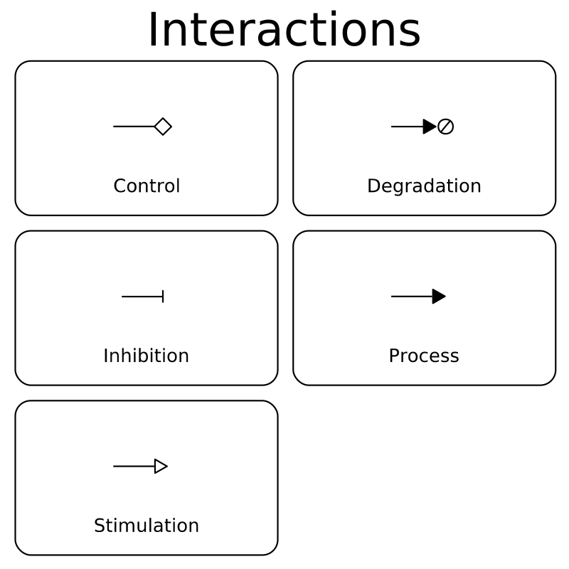
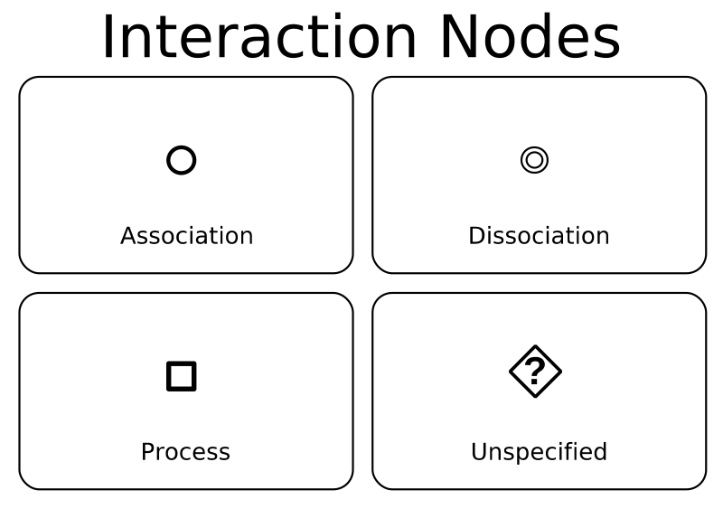
Molecular Species & Interaction Glyphs

Slide 7
Making SBOL Visual Diagrams
Using your favorite graphics editor:
Many glyphs can be drawn directly
Glyph set available: http://sbolstandard.org/visual/
Specialized visualization tools:
VisBOL: http://visbol.org/
GraphViz: http://www.graphviz.org/
DNAPlotLib: https://github.com/VoigtLab/dnaplotlib

Slide 8
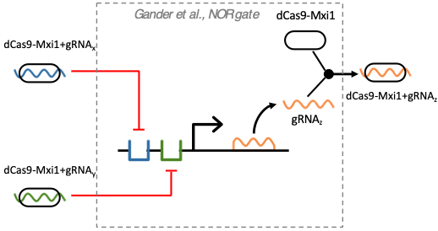
Example: CRISPR Device

Slide 9
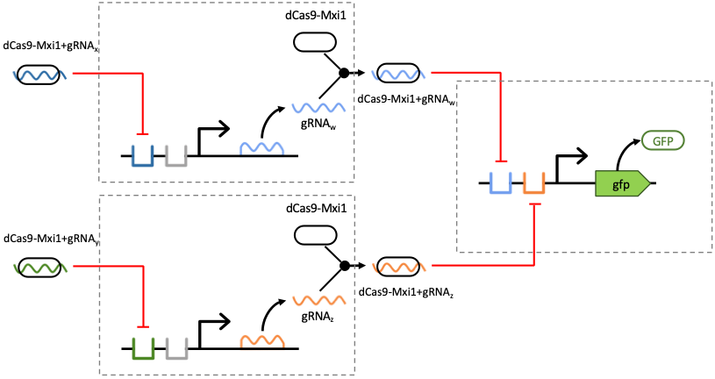
Example: CRISPR Circuit

Slide 10
Example: Rule 30 Circuit

Slide 11
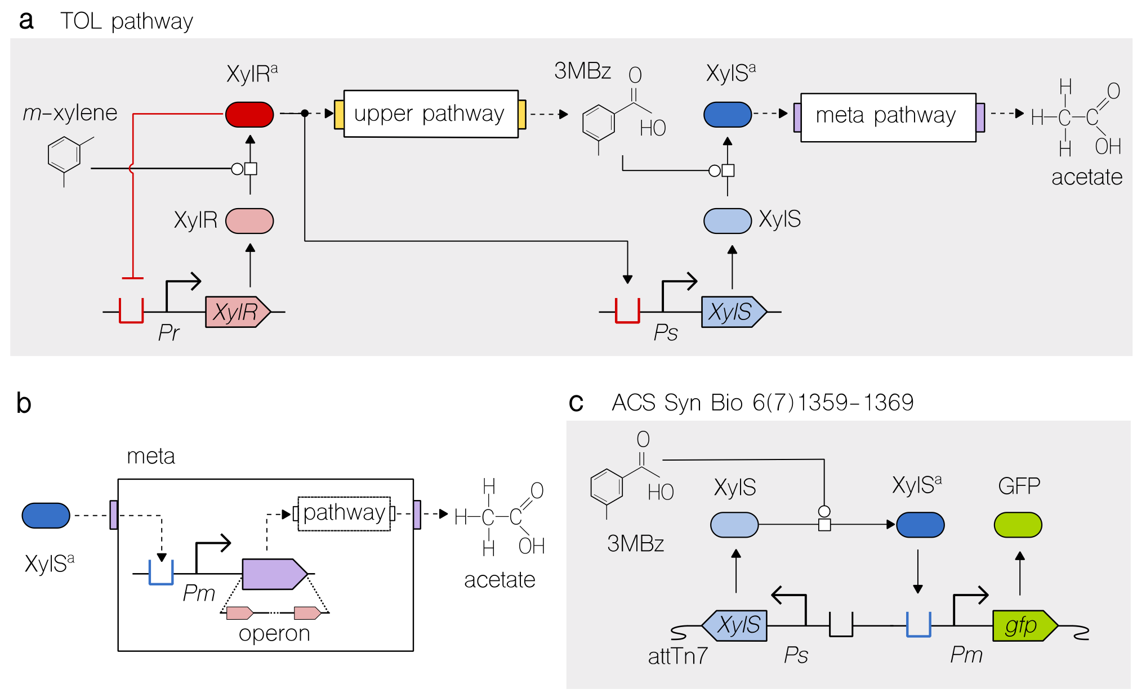
Example: Pathway Engineering

Slide 12
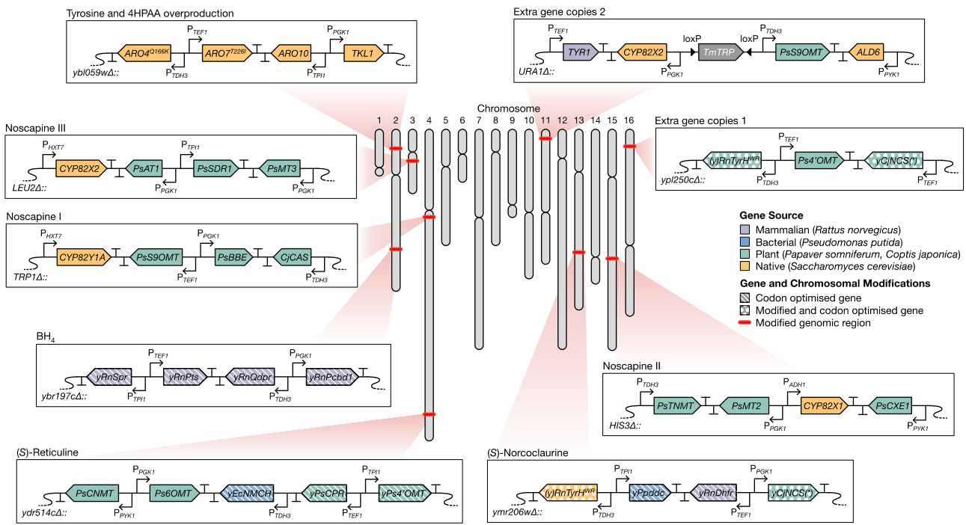
Example: Genome Engineering

Slide 13
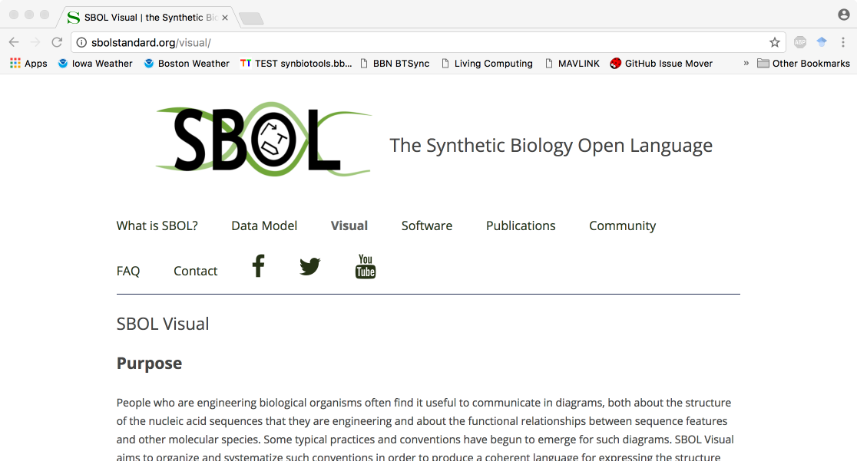
http://sbolstandard.org
Use the symbols in your papers & talks
Contribute opinions, use cases, new symbols
Community is open for anyone to join

